Slide 1
The Role of Algorithms in Problem Solving Process
CSC 102 – Introduction to Problem Solving

Slide 2
Course Outline
Role of Algorithms in problem solving process
Concepts and properties of Algorithms
Implementation strategies
Development of Flow Charts, Pseudo Codes.
Implementation of Algorithms in a programming Language - Python

Slide 3
Steps for Problem Solving
Problem Solving Steps
1. Analyzing the Problem
2. Developing an Algorithm
3.
Coding
4.
Testing and Debugging

Slide 4
What is an Algorithm?
A finite sequence of steps required to get the desired output.

Slide 5
Other Definitions
1
A finite set of unambiguous instructions performed in a prescribed sequence to achieve a goal, especially a mathematical rule or procedure used to compute a desired result.
2
A predetermined set of instructions for solving a specific problem in a limited number of steps.
3
A precise step-by-step plan for a computational procedure that possibly begins with an input value and yields an output value in a finite number of steps.

Slide 6
Why do we need an Algorithm?
A programmer writes a program to instruct the computer to do certain tasks as desired. The computer then follows the steps written in the program code. Therefore, the programmer first prepares a roadmap of the program to be written, before actually writing the code.

Slide 7
Characteristics of a Good Algorithm
Precision:
Uniqueness:
Finiteness:
The steps are precisely stated or defined.
Results of each step are uniquely defined and only depend on the input and the result of the preceding steps.
The algorithm always stops after a finite number of steps.
Input:
The algorithm receives some input.
Output:
The algorithm produces some output.

Slide 8
Characteristics of a Good Algorithm
While writing an algorithm, it is required to clearly identify the following:
The input to be taken from the user.
Processing or computation to be performed to get the desired result.
The output desired by the user.

Slide 9
Advantages of Algorithm
It is a step wise representation of a solution to a given problem, which makes it easier to understand.
An algorithm uses a definite procedure.
It is not dependent on any programming language, so it is easy to understand for anyone without programming knowledge.
Every step has its on logical sequence, so it is easy to debug

Slide 10
Representation of Algorithms
There are two common methods of representing an algorithm:
Flowcharts
Pseudocodes

Slide 11

Flowchart — Visual Representation of Algorithms
A flowchart is a diagram made up of boxes, diamonds and other shapes, connected by arrows.
Each shape represents a step of the solution process and the arrow represents the order or link among the steps.

Slide 12
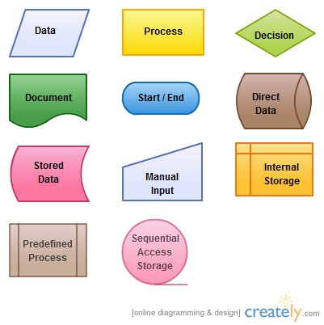
Flowchart — Visual Representation of Algorithms

Slide 13
Flowchart — Visual Representation of Algorithms
Start
Algorithm to find square of a number
Input num
square = num * num
Print square
Stop

Slide 14
Flowchart — Visual Representation of Algorithms
Start
Is the bulb switch on?
N
Switch On
A flowchart to solve the problem of a non-functioning light bulb
Y
N
Bulb On?
Is it Burnt Out?
N
Call Electrician
Y
Y
Replace the Bulb
Stop

Slide 15
Pseudocode
A pseudocode is another way of representing an algorithm.
It is considered as a non-formal language that helps programmers to write algorithm.
It is a detailed description of instructions that a computer must follow in a particular order.
It is intended for human reading and cannot be executed directly by the computer.
No specific standard for writing a pseudocode exists.

Slide 16
Pseudocode
Some of the frequently used keywords while writing pseudocode:
INPUT
COMPUTE
PRINT
INCREMENT
DECREMENT
IF/ELSE
WHILE
TRUE/FALSE

Slide 17
Pseudocode Example
Write an algorithm to calculate area and perimeter of a rectangle, using both pseudocode and flowchart.
Pseudocode for calculating area and perimeter of a rectangle
INPUT length INPUT breadth COMPUTE Area = length * breadth PRINT Area COMPUTE Perim = 2 * (length + breadth) PRINT Perim

Slide 18
The Flowchart
Start
Input length, breadth
Area = length * breadth
Print Area
Perim = 2 * (length + breadth)
Print Perim
Stop

Slide 19
Benefits of Pseudocode
Pseudocode helps in representing the basic functionality of the intended program.
By writing the code first in a human readable language, the programmer safeguards against leaving out any important step.
For non-programmers, actual programs are difficult to read and understand, but pseudocode helps them to review the steps to confirm that the proposed implementation is going to achieve the desire output.

Slide 20
Algorithm Assignment
CSC 102 – Introduction to Problem Solving

Slide 21
Instructions
Create a PowerPoint Presentation titled <yournameAA1>.pptx
Use a slide to:
Create a title description of the exercise.
Generate the Algorithm (Flowchart and Pseudocode) of the following exercises.
Commit to your GitHub Repository
Example: ChukwudiAA1.pptx

Slide 22
Exercises
Algorithm to find:
Find the root of a Quadratic Equation Ax² +Bx + C = 0
Find the root of a Cubic Equation Ax³ + Bx² + Cx + D = 0
Find the largest of three numbers.
Find the GCD and LCM of two numbers.
Find the Factorial of number n (n! = 1 x 2 x 3 x …. n)

